Slide 1
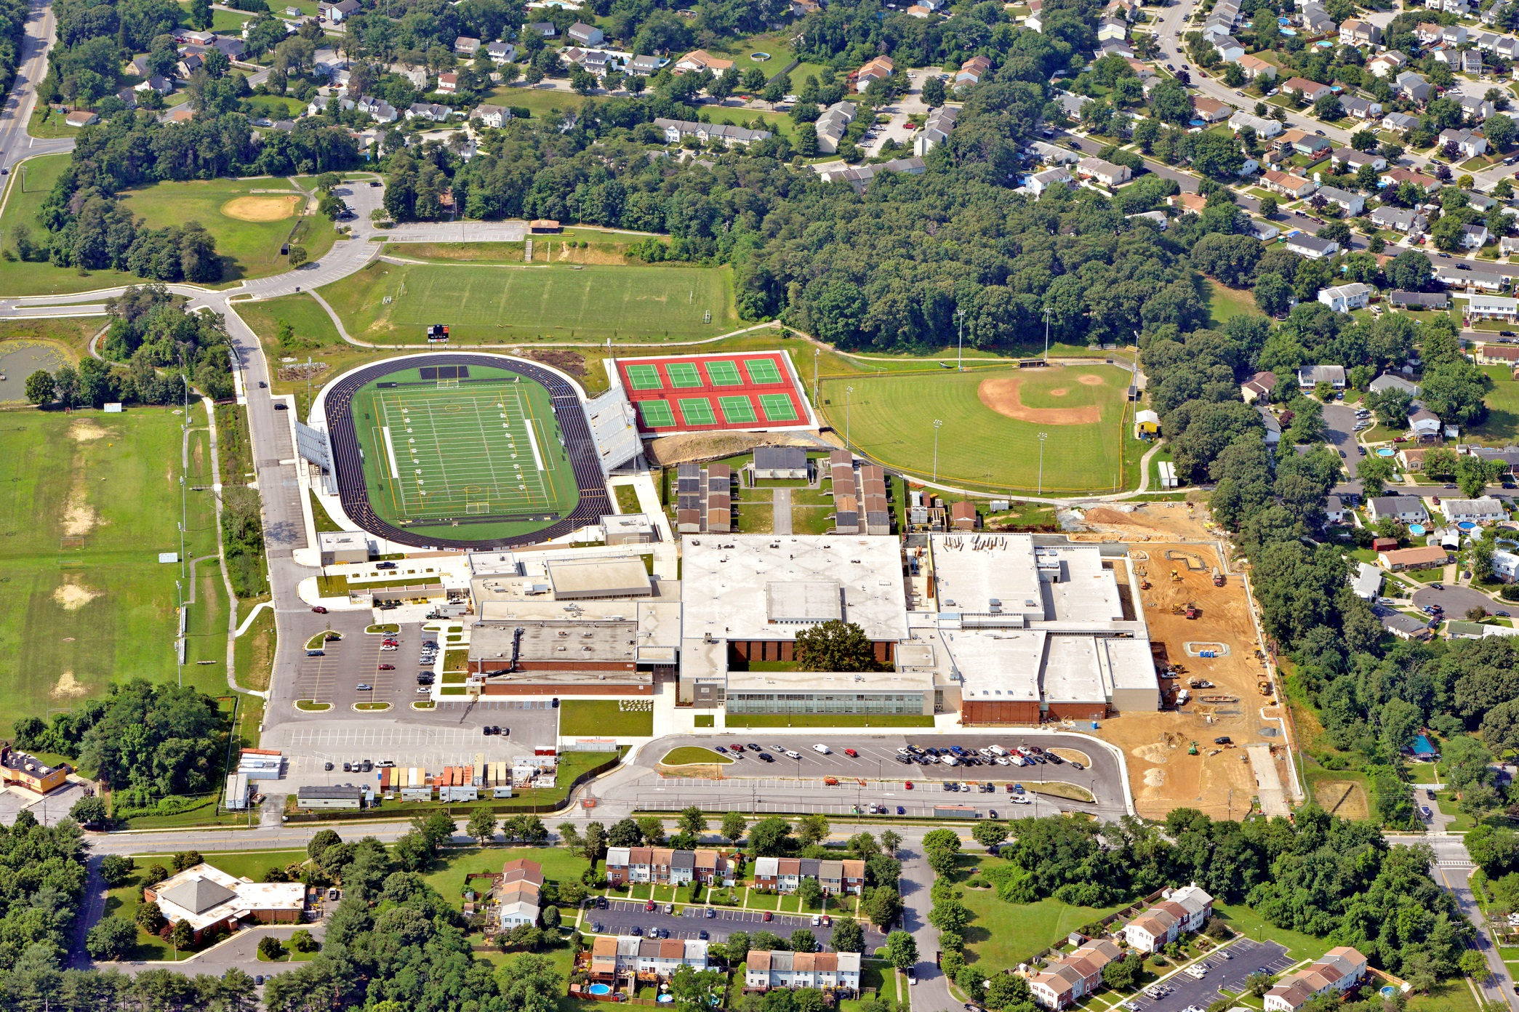
Central High School
Central High School
Introduction
Existing Mechanical System
Thesis Proposal
Mechanical Breadth
GCHP Sizing / Layout
Energy Savings
Acoustical Breadth
Construction Breadth
Conclusion
MID-ATLANTIC REGION
ADAM BROWN MECHANICAL OPTION SPRING 2014
ADAM BROWN MECHANICAL OPTION SPRING 2014

Slide 2
Central High School
  1st floor renovation
  2nd floor addition
Location - Mid Atlantic Region
Size - 322,000 sq. ft.
Project Cost - $84 million
Completion - February 2015
Central High School
Introduction
Existing Mechanical System
Thesis Proposal
Mechanical Breadth
GCHP Sizing / Layout
Energy Savings
Acoustical Breadth
Construction Breadth
Conclusion
ADAM BROWN MECHANICAL OPTION SPRING 2014

Slide 3
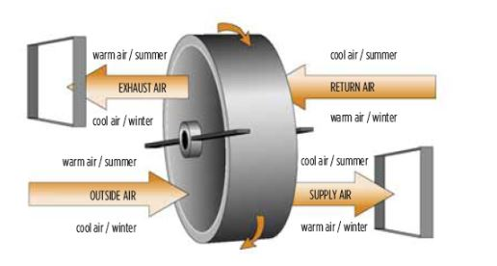
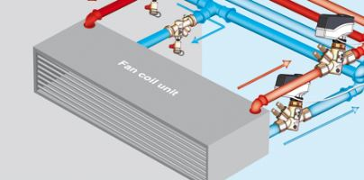
Heating Water System
  1 natural gas boiler
Chilled Water System
  2 air cooled chillers
Air Handling Units
  20 DOAS units
  Energy recovery wheels
4 pipe fan coil units
Central High School
Introduction
Existing Mechanical System
Thesis Proposal
Mechanical Breadth
GCHP Sizing / Layout
Energy Savings
Acoustical Breadth
Construction Breadth
Conclusion
ADAM BROWN MECHANICAL OPTION SPRING 2014

Slide 4
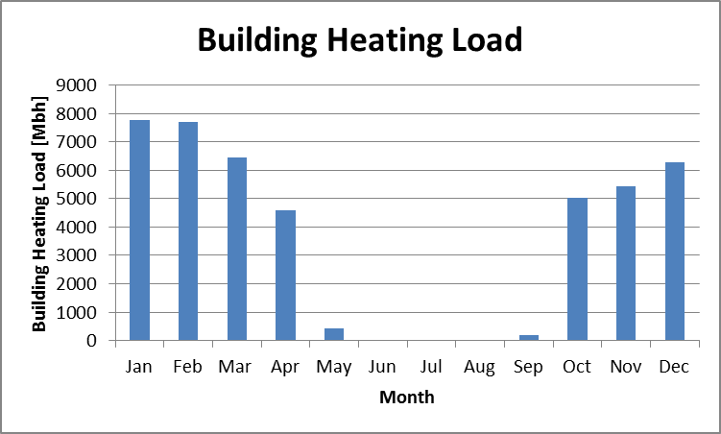
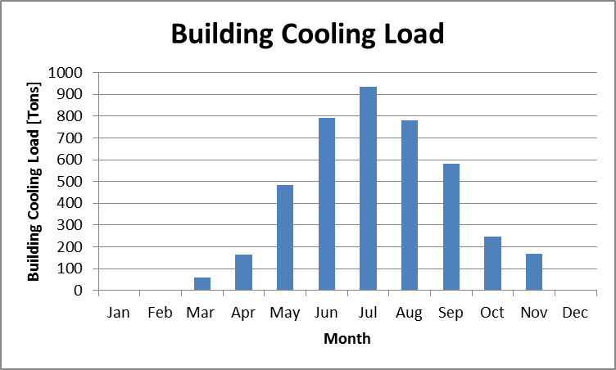
Central High School
Introduction
Existing Mechanical System
Thesis Proposal
Mechanical Breadth
GCHP Sizing / Layout
Energy Savings
Acoustical Breadth
Construction Breadth
Conclusion
Peak Heating Load – 7766 Mbh
Peak Cooling Load – 934 Tons
ADAM BROWN MECHANICAL OPTION SPRING 2014

Slide 5
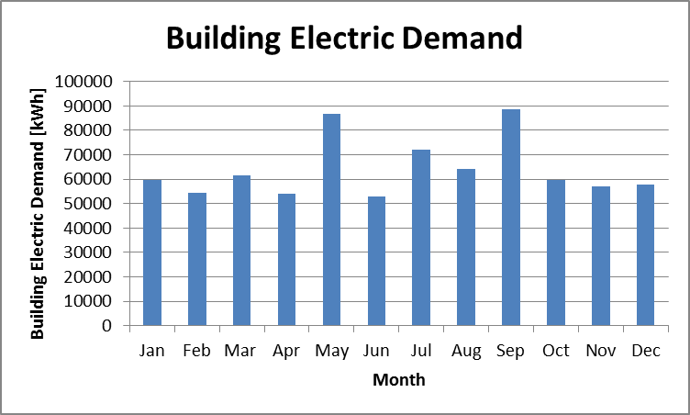
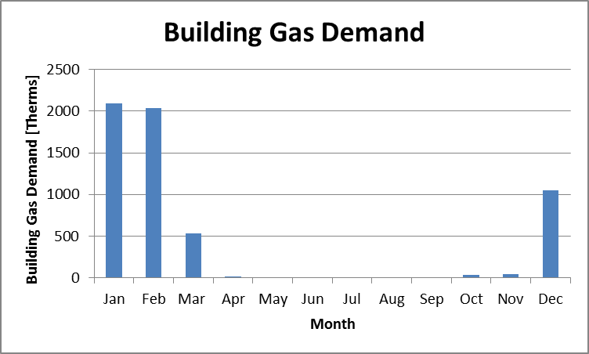
Central High School
Introduction
Existing Mechanical System
Thesis Proposal
Mechanical Breadth
GCHP Sizing / Layout
Energy Savings
Acoustical Breadth
Construction Breadth
Conclusion
Peak Electric Demand – 88681 kWh
Peak Gas Demand – 2094 Therms
ADAM BROWN MECHANICAL OPTION SPRING 2014

Slide 6
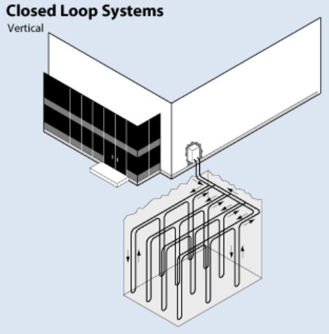
Central High School
Goals
  REDUCE energy demand
  REDUCE environmental impact
  INCREASE maintainability
Introduction
Existing Mechanical System
Thesis Proposal
Mechanical Breadth
GCHP Sizing / Layout
Energy Savings
Acoustical Breadth
Construction Breadth
Conclusion
Proposal
  Ground Coupled Heat Pump System
    Heat Pumps
    Packaged ERUs
    Hydronic Pumps
ADAM BROWN MECHANICAL OPTION SPRING 2014

Slide 7
Central High School
Vertical Bore Layout
Well Field
  Increase depth of well
  Decrease amount of wells
Oversize Well Field
  1000 Tons
  Soccer Field
  Future capacity
  No supplemental boiler / cooling tower
Introduction
Existing Mechanical System
Thesis Proposal
Mechanical Breadth
GCHP Sizing / Layout
Energy Savings
Acoustical Breadth
Construction Breadth
Conclusion
ADAM BROWN MECHANICAL OPTION SPRING 2014

Slide 8
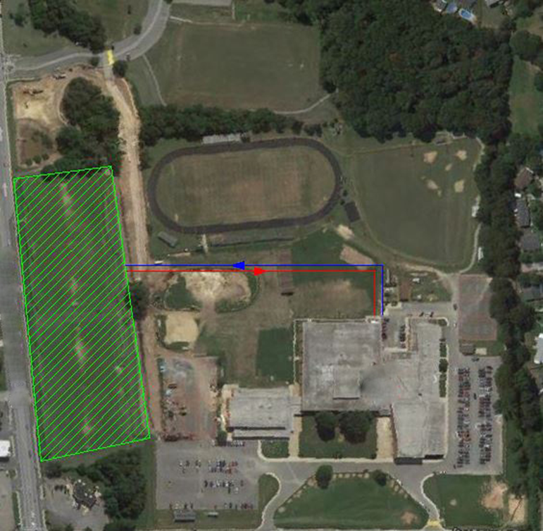
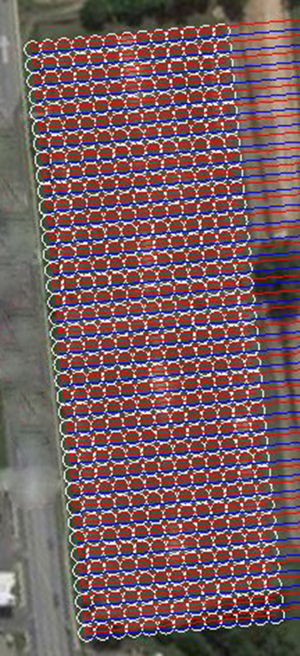
Central High School
Well Field Layout
  38 rows
  13 wells per row
  Reverse return
Introduction
Existing Mechanical System
Thesis Proposal
Mechanical Breadth
GCHP Sizing / Layout
Energy Savings
Acoustical Breadth
Construction Breadth
Conclusion
ADAM BROWN MECHANICAL OPTION SPRING 2014

Slide 9
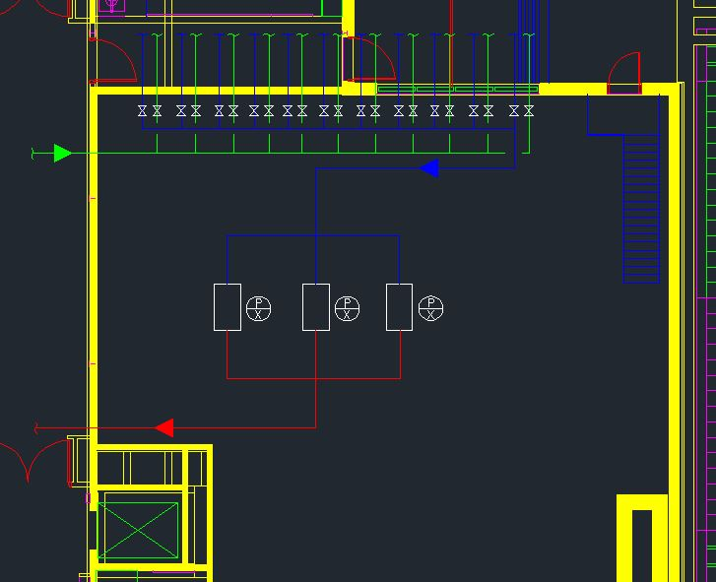
Central High School
Individual runs
  Emergency shutoff
3 VFD pumps
  2 primary pumps
  1 redundant
Increase maintainability
Introduction
Existing Mechanical System
Thesis Proposal
Mechanical Breadth
GCHP Sizing / Layout
Energy Savings
Acoustical Breadth
Construction Breadth
Conclusion
ADAM BROWN MECHANICAL OPTION SPRING 2014

Slide 10
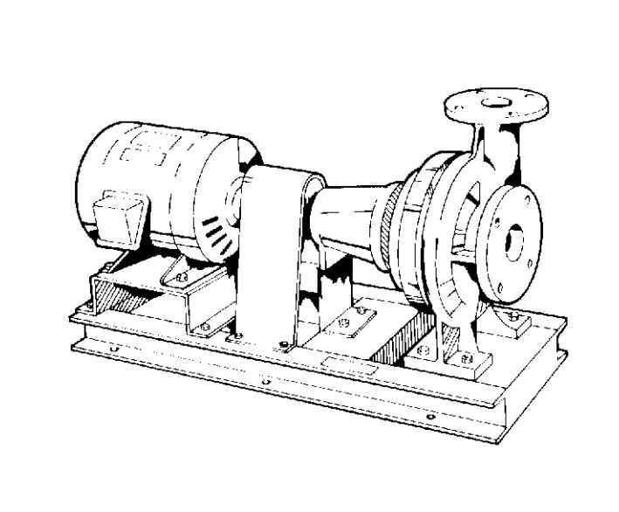
Central High School
Heat Pump Selection
  Carrier
  Typical 1 – 3 ton units
Introduction
Existing Mechanical System
Thesis Proposal
Mechanical Breadth
GCHP Sizing / Layout
Energy Savings
Acoustical Breadth
Construction Breadth
Conclusion
Energy Recovery Unit Selection
  SEMCO
  Packaged
  Water to water source heat pumps
  Enthalpy & Sensible wheels
ADAM BROWN MECHANICAL OPTION SPRING 2014

Slide 11
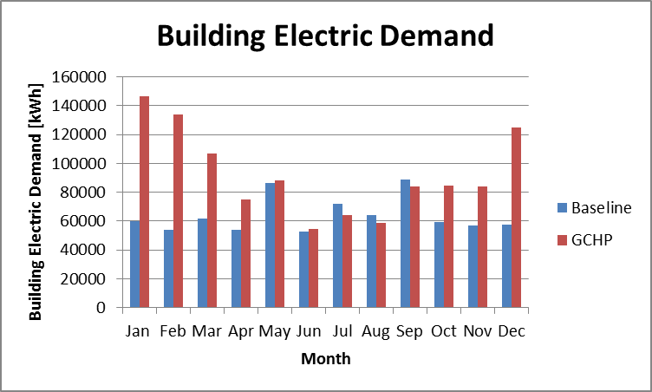
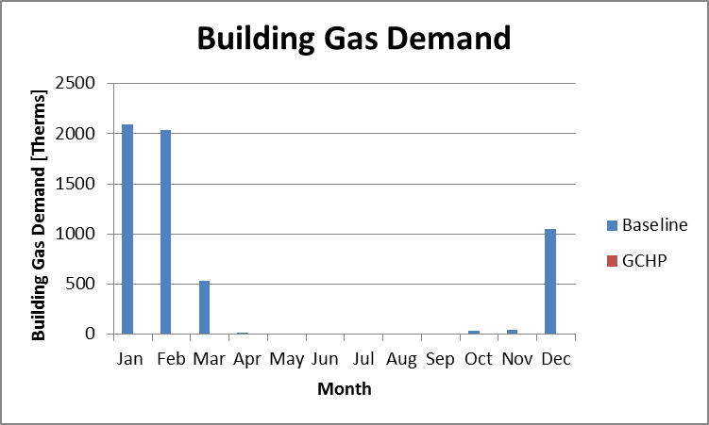
Central High School
Introduction
Existing Mechanical System
Thesis Proposal
Mechanical Breadth
GCHP Sizing / Layout
Energy Savings
Acoustical Breadth
Construction Breadth
Conclusion
ADAM BROWN MECHANICAL OPTION SPRING 2014

Slide 12
Central High School
Electricity increase 45%
Energy decrease 35%
Savings of $19074 per year
Introduction
Existing Mechanical System
Thesis Proposal
Mechanical Breadth
GCHP Sizing / Layout
Energy Savings
Acoustical Breadth
Construction Breadth
Conclusion
ADAM BROWN MECHANICAL OPTION SPRING 2014

Slide 13
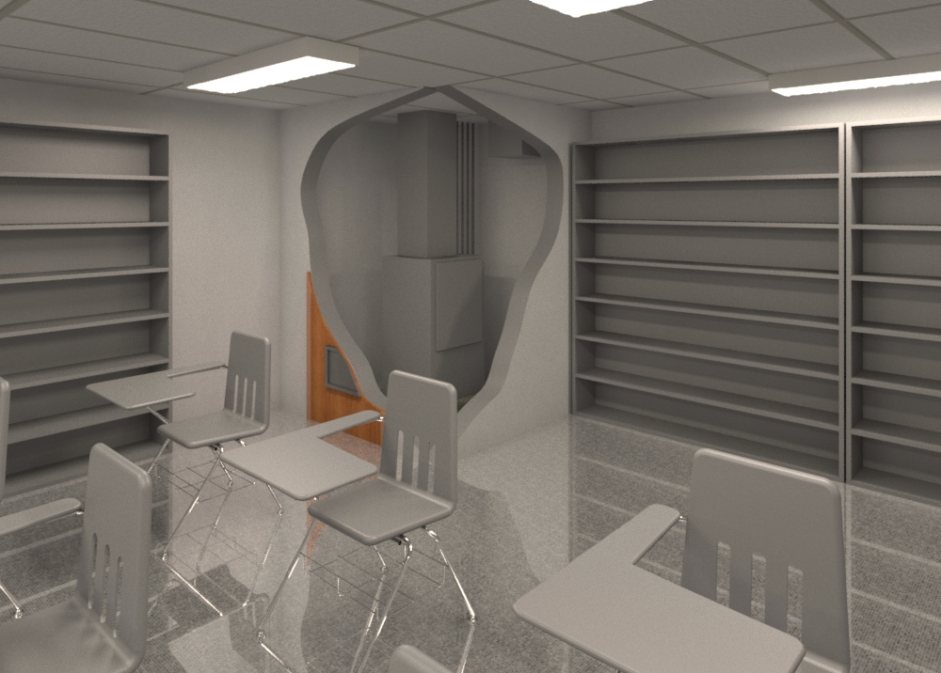
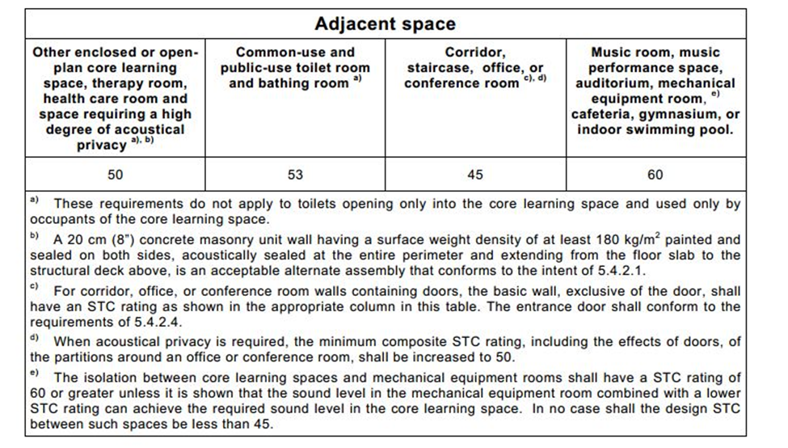
Central High School
Introduction
Existing Mechanical System
Thesis Proposal
Mechanical Breadth
GCHP Sizing / Layout
Energy Savings
Acoustical Breadth
Construction Breadth
Conclusion
ADAM BROWN MECHANICAL OPTION SPRING 2014

Slide 14
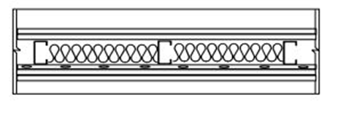
Central High School
Heat Pump closet
  Typical for classrooms
  Achieves mitigation of sound through wall
  Meets ANSI S12.60 standard
Introduction
Existing Mechanical System
Thesis Proposal
Mechanical Breadth
GCHP Sizing / Layout
Energy Savings
Acoustical Breadth
Construction Breadth
Conclusion
ADAM BROWN MECHANICAL OPTION SPRING 2014

Slide 15
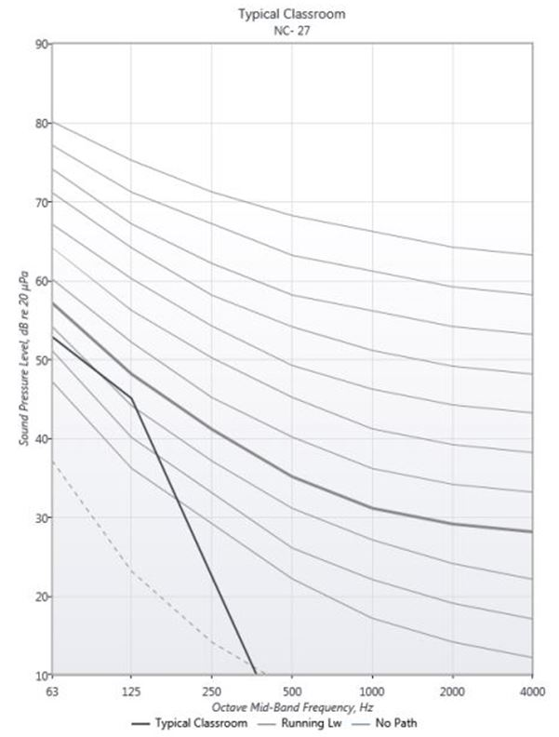
Central High School
NC 30 required
  Low frequency issues
Introduction
Existing Mechanical System
Thesis Proposal
Mechanical Breadth
GCHP Sizing / Layout
Energy Savings
Acoustical Breadth
Construction Breadth
Conclusion
Low Frequencies
  Heat Pump emits most noise
  Mitigate sound through ductwork
NC 27 achieved
ADAM BROWN MECHANICAL OPTION SPRING 2014

Slide 16
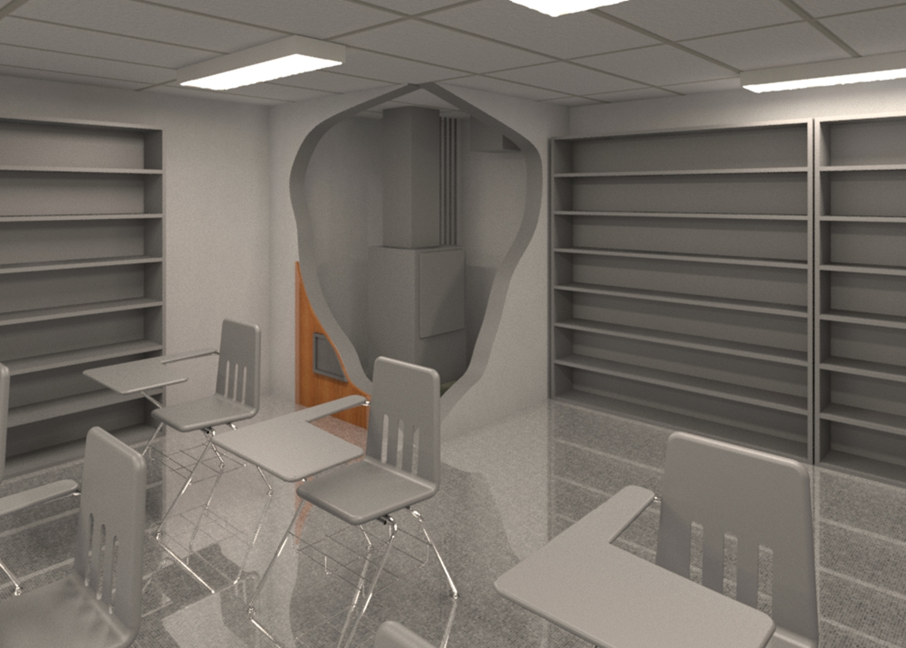
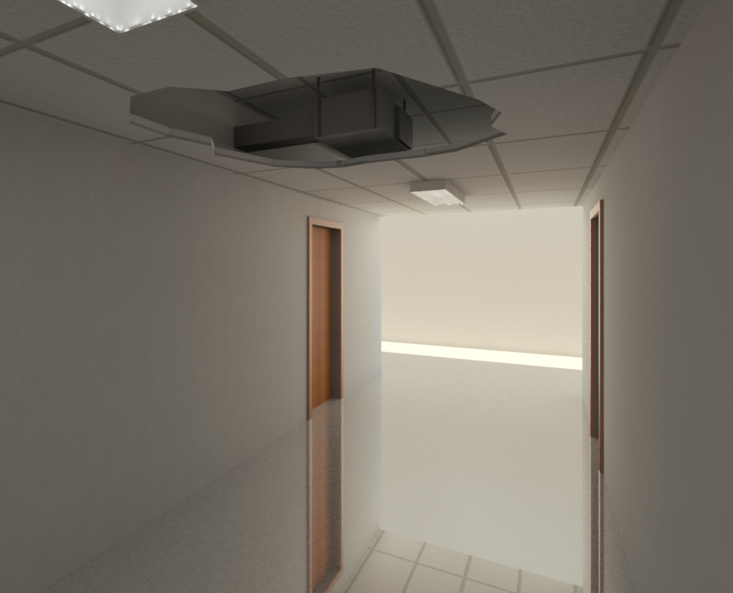
Central High School
Introduction
Existing Mechanical System
Thesis Proposal
Mechanical Breadth
GCHP Sizing / Layout
Energy Savings
Acoustical Breadth
Construction Breadth
Conclusion
ADAM BROWN MECHANICAL OPTION SPRING 2014

Slide 17
Central High School
Introduction
Existing Mechanical System
Thesis Proposal
Mechanical Breadth
GCHP Sizing / Layout
Energy Savings
Acoustical Breadth
Construction Breadth
Conclusion
Cost Difference of $3643.89
Duration Difference of 2 days
Coordination Issues Difference of 2
ADAM BROWN MECHANICAL OPTION SPRING 2014

Slide 18
Central High School
Goals
  REDUCE energy demand
  REDUCE environmental impact
  INCREASE maintainability
Conclusions
  GCHP
    REDUCED site energy
    INCREASED environmental impact
    INCREASED maintainability
Introduction
Existing Mechanical System
Thesis Proposal
Mechanical Breadth
GCHP Sizing / Layout
Energy Savings
Acoustical Breadth
Construction Breadth
Conclusion
Heat Pump Closet
  MEETS ANSI standards
  NOT feasible to construct
ADAM BROWN MECHANICAL OPTION SPRING 2014

Slide 19
Central High School
Acknowledgements
Jacobs
SHW Group
Thesis Advisor
AE Faculty
Family & Friends
Classmates
THANK YOU!
Introduction
Existing Mechanical System
Thesis Proposal
Mechanical Breadth
GCHP Sizing / Layout
Energy Savings
Acoustical Breadth
Construction Breadth
Conclusion
ADAM BROWN MECHANICAL OPTION SPRING 2014

Slide 20
References
SHW Group LLP “Final Bid Set”. Reston, Virginia.
Central High School “Master Specifications”.
ASHRAE. Standard 62.1-2010, Ventilation for Acceptable Indoor Air Quality. Atlanta, GA. American Society of Heating Refrigeration and Air Conditioning Engineers, Inc.
ASHRAE. Standard 90.1-2010, Energy Standards for Buildings Except Low-Rise Residential Buildings. Atlanta, GA. American Society of Heating Refrigeration and Air Conditioning Engineers, Inc.
ANSI/ASA S12.60-2010, American National Standard Acoustical Performance Criteria, Design Requirements, and Guidelines for Schools, Part 1: Permanent Schools. Melville, NY. Acoustical Society of America.
Halliwell, R.E., Nightingale, T. R. T., Warnock, A. C. C., Birta, J. A. Gypsum Board Walls: Transmission Loss Data. 1998. NRC-CNRC.
Mossman, Melville. Plumbing Cost Data, 2014. N.p.: Means, Incorporated, R. S, 2013. Print.
Central High School
Mossman, Melville. Mechanical Cost Data, 2014. N.p.: Means, Incorporated, R. S, 2013. Print.
Phelan, Marilyn. Assemblies Cost Data, 2014. N.p.: Means, Incorporated, R. S, 2013. Print.
Faculty Consultations
Introduction
Existing Mechanical System
Thesis Proposal
Mechanical Breadth
GCHP Sizing / Layout
Energy Savings
Acoustical Breadth
Construction Breadth
Conclusion
ADAM BROWN MECHANICAL OPTION SPRING 2014

Slide 21
Central High School
Introduction
Existing Mechanical System
Thesis Proposal
Mechanical Breadth
GCHP Sizing / Layout
Energy Savings
Acoustical Breadth
Construction Breadth
Conclusion
Questions?
ADAM BROWN MECHANICAL OPTION SPRING 2014

